Slide 1
Exploratory Data Analysis
Unit 02 Lecture 03
Instructor: Dr. Muhammad Ismail Mangrio

Slide 2
Contents
Elements of Structured Data
Rectangular Data
Estimates of Location
Estimates of Variability
Exploring the Data Distribution
Exploring Binary and Categorical Data
Correlation
Exploring Two or More Variables
Hexagonal Binning and Contours

Slide 3
Elements of Structured Data
Data comes from many sources: sensor measurements, events, text, images, and
videos.
The Internet of Things (IoT) is producing streams of information.
Much of this data is unstructured:
  images are a collection of pixels, with each pixel containing RGB (red, green, blue) color information.
  Texts are sequences of words and nonword characters, often organized by sections,
subsections, and so on.
  Clickstreams are sequences of actions by a user interacting with an app or a web page.
A major challenge of data science is to harness/attach this torrent/stream of raw
data into actionable information.
To apply the statistical concepts, unstructured raw data must be processed and manipulated into a structured form.
One of the commonest forms of structured data is a table with rows and columns
  as data might emerge from a relational database or be collected for a study.

Slide 4
Elements of Structured Data
It is important to know the type of data as it helps to find the right type of visual display, data analysis or statistical modeling
A data typing in software acts as a signal to the software on how to process the data.
There are two basic types of structured data: numeric and categorical.
Numeric is the data that is expressed on numeric scale. It comes in two forms:
  Continuous is the form that can take on any value in tan interval (float, interval are synonyms), such as
wind speed or time duration, and
  Discrete is the form that can take on only integer values e.g., counts of an event.
Categorical data take only a specific set of values representing a set of possible categories. It comes with two forms:
  such as a type of TV screen (plasma, LCD, LED, etc.) or a state name (Ala‐bama, Alaska, etc.).
Binary data is an important special case of categorical data that takes on only one of two values,
  such as 0/1, yes/no, or true/false.
➢ Ordinal data is another useful type of categorical data in which the categories are ordered;
➢ an example of this is a numerical rating (1, 2, 3, 4, or 5), grading.

Slide 5
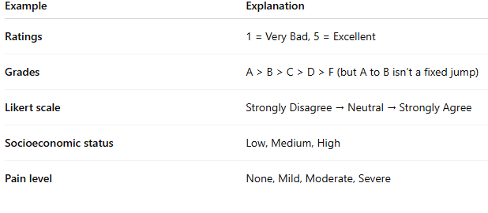
Ordinal data

Slide 6
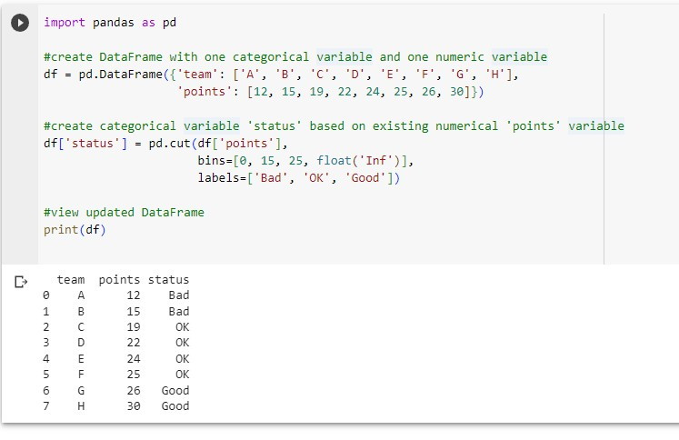
Elements of Structured Data (Categorical data creation in Python)
Link: Study cut() method of python
5

Slide 7
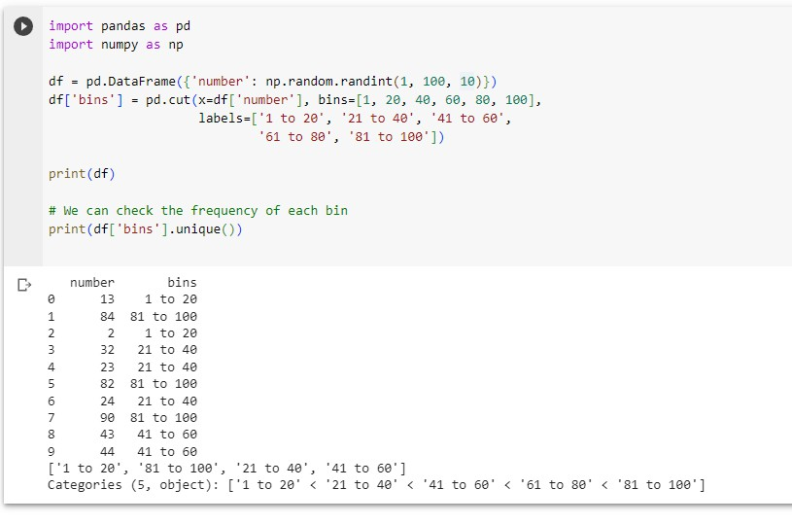
Elements of Structured Data (Categorical data creation in Python)

Slide 8
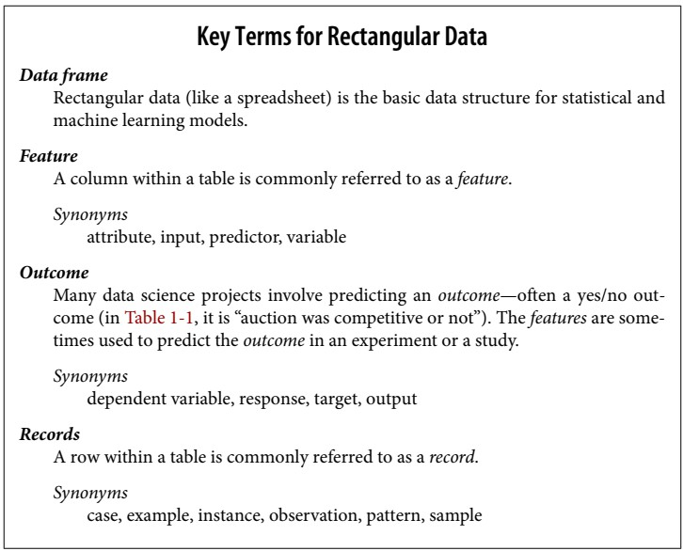
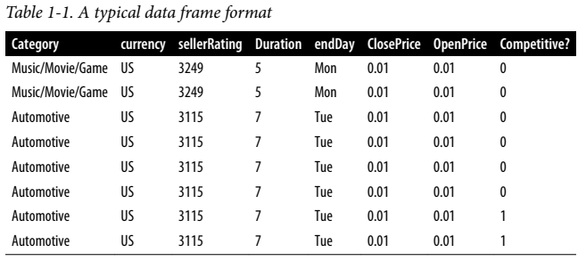
Rectangular Data
▶ The typical frame of reference for an analysis in data science is a rectangular data object, like a spreadsheet or database table.
▶ Rectangular data is the general term for a two-dimensional matrix with
▶ rows indicating records (cases) and
▶ columns indicating features (variables);
▶ data frame is the specific format in Python.
▶ The data doesn’t always start in rectangular form:
▶ unstructured data (e.g., text) must be processed and manipulated so that it can be represented as a set of features in the rectangular data.
▶ Data in relational databases must be extracted and put into
a single table for most data analysis and modeling tasks.

Slide 9

Rectangular Data

Slide 10
Rectangular Data
In Table 1-1, there is a mix of measured or counted data (e.g.,
duration and price) and categorical data (e.g., category and currency).
A special form of categorical variable is a binary (yes/no or 0/1) i.e.,
competitive
  competitive attribute indicates whether an auction was competitive (had multiple bidders) or not.
  It can be used as predictor/label for predictive modeling.

Slide 11
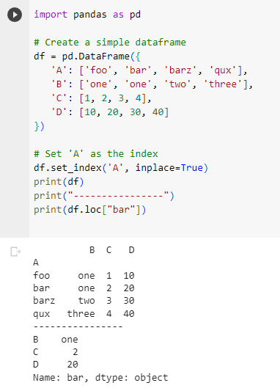
Rectangular Data(Data Frames and Indexes)
Index in Pandas: An index in Pandas is like an address, it’s how any data point across the DataFrame or series can be accessed. Indexes can be numeric, string, or even datetime. They can also be unique or non-unique. By default, Pandas assigns a numeric, auto-incrementing index to each DataFrame you create.
Indexing is important for two main reasons: Link to indexing
  Identification: Unique identifiers help in identifying
rows with specific characteristics.
  Selection: Indexes make data selection and manipulation faster and easier.

Slide 12
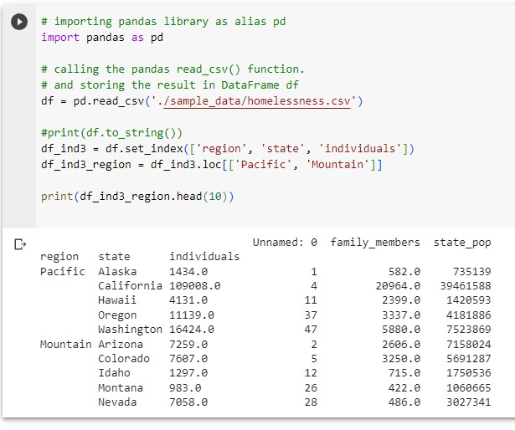
Rectangular Data(Data Frames and Indexes)
Traditional database tables have one or more columns designated as an index, essentially a row number. This can vastly improve the efficiency of certain database queries.
In Python, with the pandas library, the basic rectangular data structure is a DataFrame object.
By default, an automatic integer index is created for a DataFrame based on the order of the rows.
In pandas, it is also possible to set multilevel/hierarchical indexes to improve the efficiency of certain operations.
  Hierarchical Indexes are also known as multi- indexing is setting more than one column name as the index. Link to hierarchical indexing

Slide 13
Nonrectangular Data Structures
Time series data records successive measurements of the same variable.
  It is the raw material for statistical forecasting methods, and it is also a key component of the data produced by devices—the IoT.
  Time series is a series of data points in which each data point is associated with a timestamp. A simple example is the price of a stock in the stock market at different points of time on a given day. Another example is the amount of rainfall in a region at different months of the year.
Spatial data structures, which are used in mapping and location analytics, are more complex and varied than rectangular data structures.
  In the object representation, the focus of the data is an object (e.g., a house) and its spatial coordinates.
  The field view, by contrast, focuses on small units of space and the value of a relevant metric (pixel brightness, for example) Python spatial data reading
Graph (or network) data structures are used to represent physical, social, and abstract relationships. For example,
  Facebook or LinkedIn, may represent connections between people on the network.
  Distribution hubs connected by roads are an example of a physical network.
  Graph structures are useful for certain types of problems, such as network optimization and
recommender systems.
Each of these data types has its specialized methodology in data science.
12

Slide 14
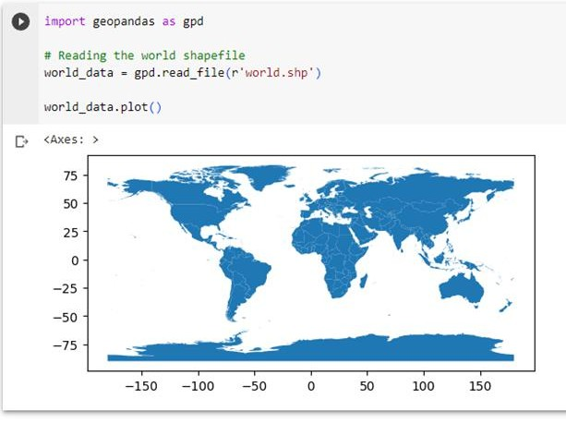
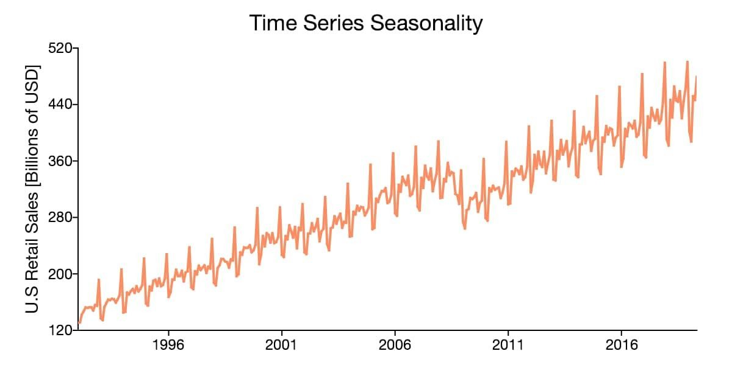
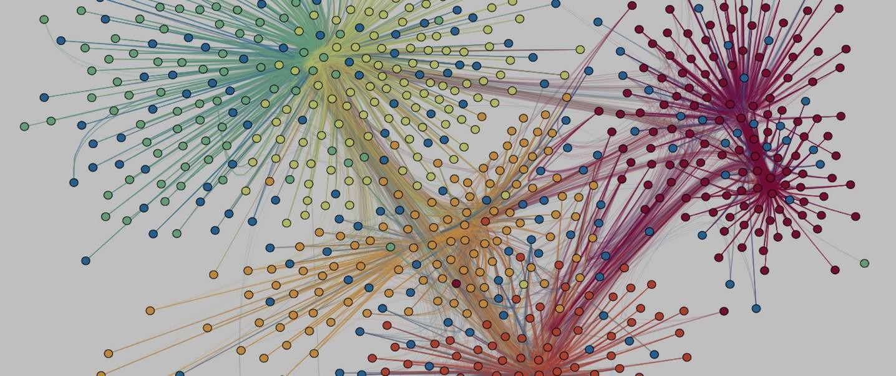
13

Slide 15
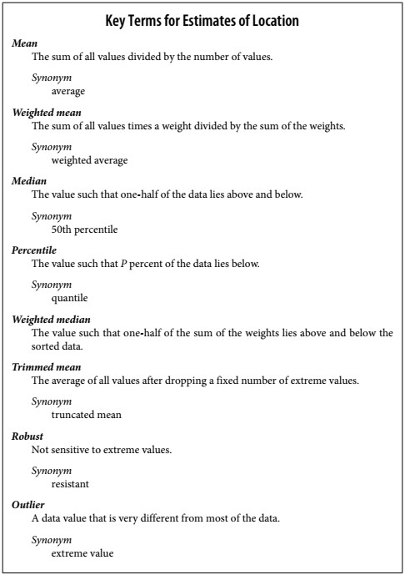
Estimates of Location
Variables with measured or count data might have thousands of distinct values.
A basic step in exploring your data is getting a “typical value” for each feature (variable): an estimate of where most of the data is located (i.e., its central tendency).
Summarizing data might seem fairly trivial
/minor: just take the mean of the data.
The mean is easy to compute and expedient/useful to use,
  it may not always be the best measure for a central value.
  For this reason, statisticians have developed and promoted several alternative estimates to the mean.
14

Slide 16

Mean
The most basic estimate of location is the mean, or average value. The mean is the sum of all values divided by the number of values
You will encounter the symbol x (pronounced “x-bar”) being used to represent the mean of a sample from a population. The formula to compute the mean for a set of n values x1, x2, ..., xn is:
N (or n) refers to the total number of records or observations. In statistics N refers to a population whereas n is a sample from a population.
The basic metric for location is the mean, but it can be sensitive to
extreme values (outlier).
15

Slide 17
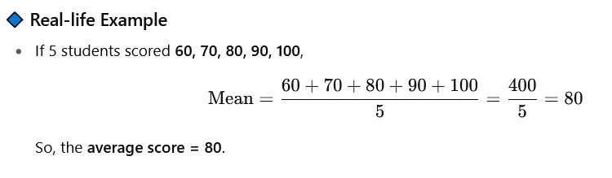

Slide 18

Trimmed Mean
A variation of the mean is a trimmed mean, which you calculate by dropping a fixed number of sorted values at each end and then taking an average of the remaining values. Representing the sorted values by x 1 , x 2 ,
..., x n where x 1 is the smallest value and x n the largest, the formula to compute the trimmed mean with p smallest and largest values omitted is:
A trimmed mean eliminates the influence of extreme values. For example, in international diving the top score and bottom score from five judges are dropped, and the final score is the average of the scores from the three remaining judges. This makes it difficult for a single judge to manipulate the score, perhaps to favor their country’s contestant. Trimmed means are widely
used, and in many cases are preferable to using the ordinary mean
16

Slide 19
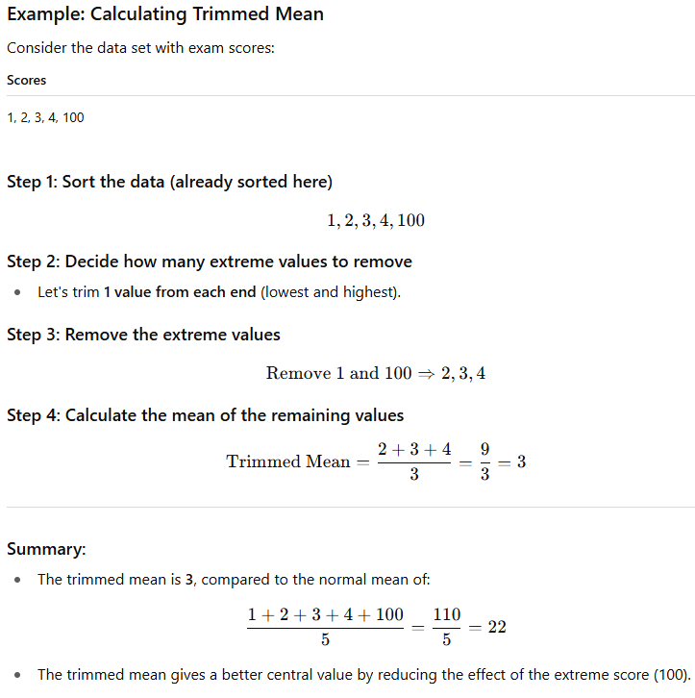

Slide 20
Trimmed Mean Vs Mean
Find the 10% trimmed mean and mean of the following set of data:
12, 23,14,19, 30,17, 20, 222, 24, 25, 26, 40, 70, 26, 50, 56, 52
Mean= ?
10% trimmed mean = ?
First sort data in an order
Divide total number of items by trim percentage like 10/10=1
It means remove one observation from each side (first and last
item)
find the average called trimmed mean
Also, find the mean

Slide 21
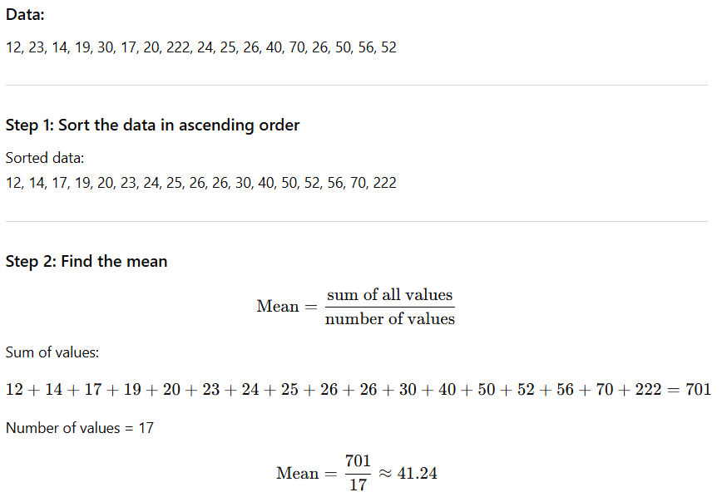

Slide 22
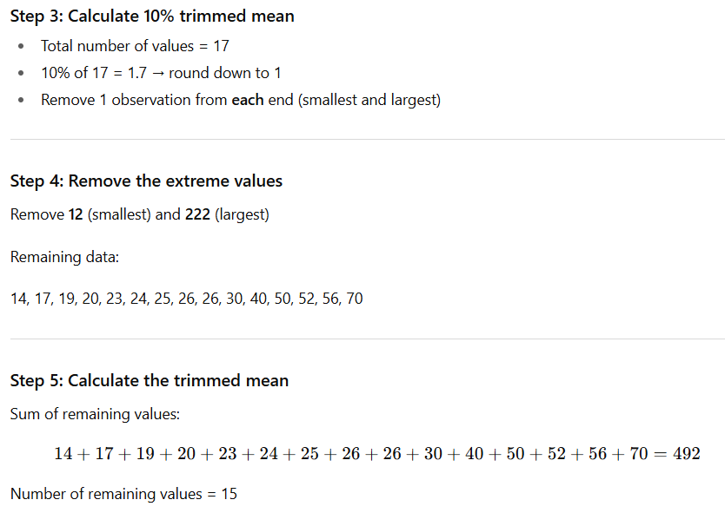
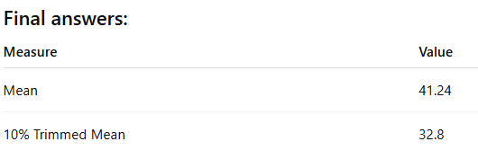

Slide 23
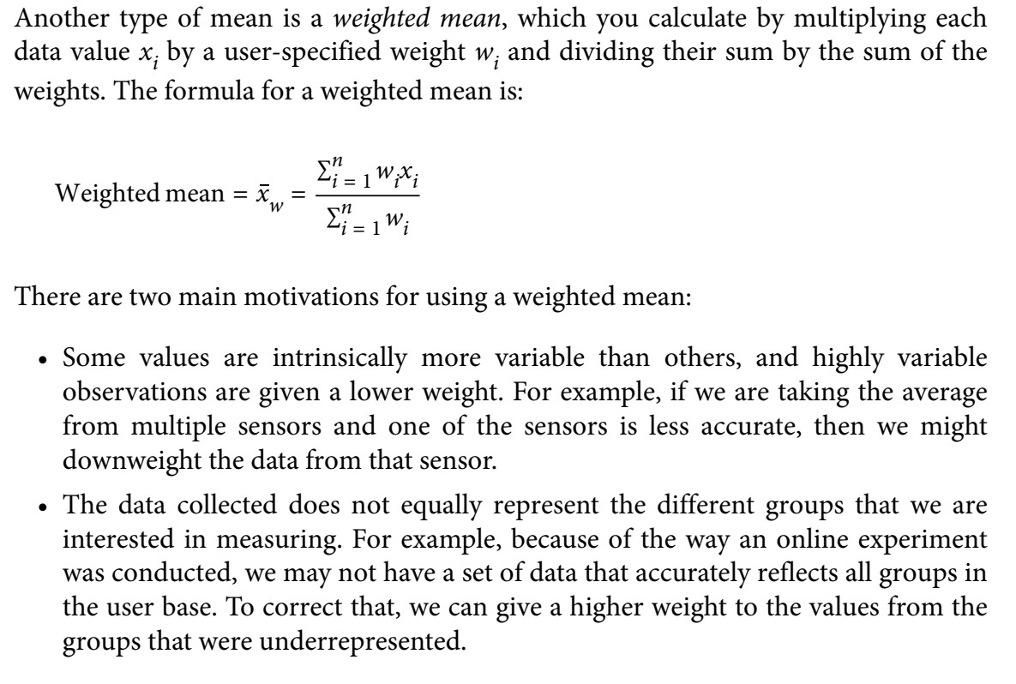
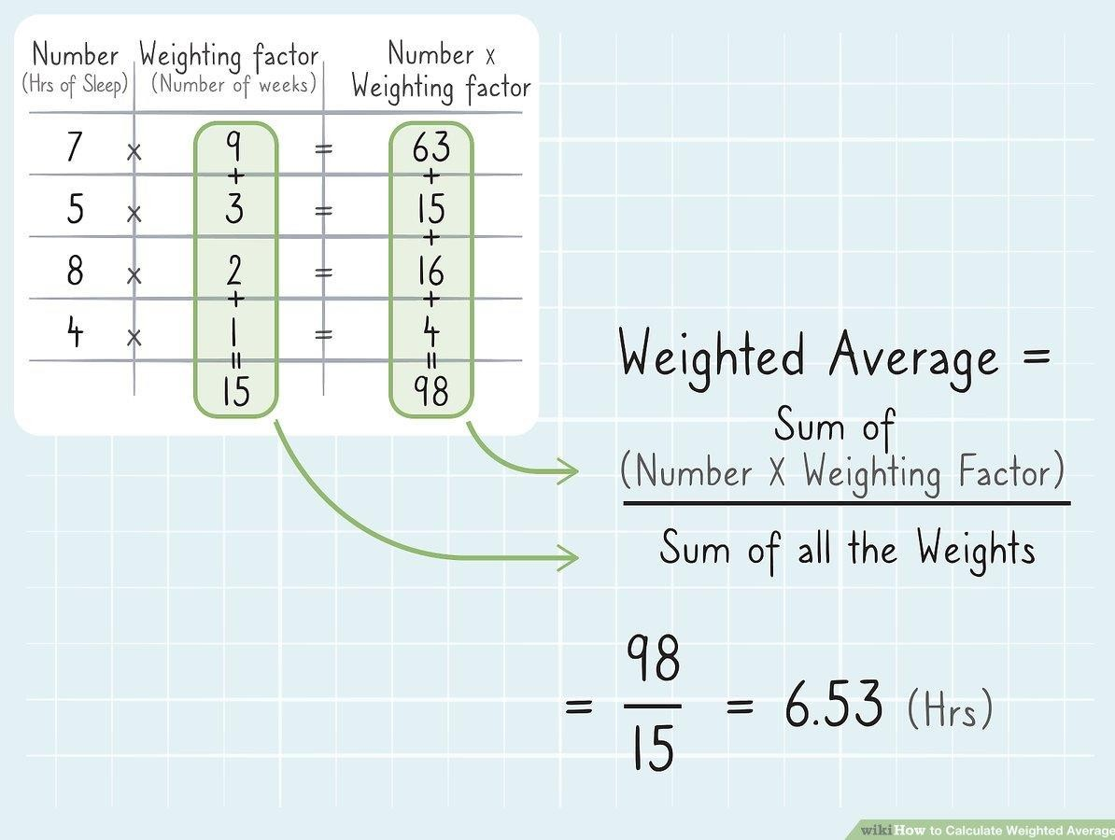
Weighted Mean

Slide 24
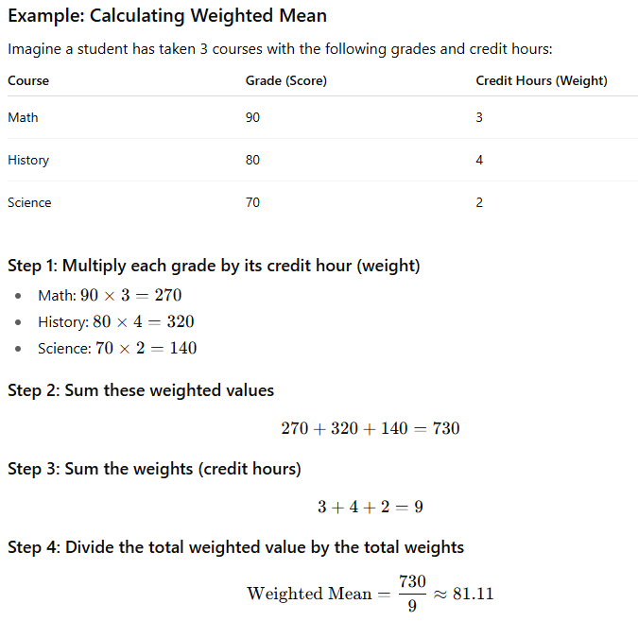

Slide 25
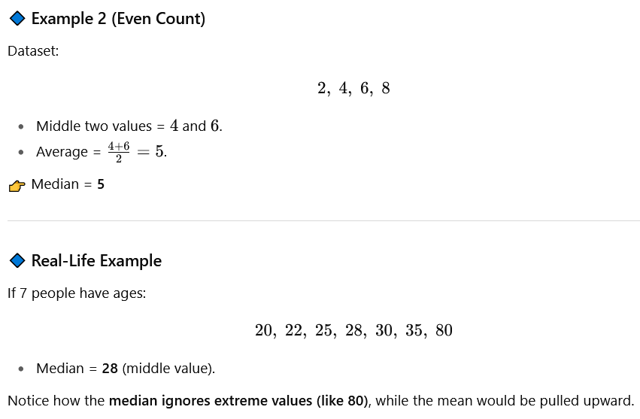
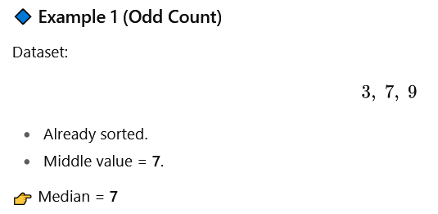
Median and Robust Estimates
The median is the middle number on a sorted list of the data.
  If even numbers data values, average of middle two number will be median
Unlike mean, median is robust to outliers
Mean → affected by outliers.
Median → resistant to outliers, better for skewed data
19

Slide 26
Weighted Median:
we first sort the data, although each data value has an
associated weight.
Instead of the middle number, the weighted median is a value such that the sum of the weights is equal for the lower and upper halves of the sorted list.
Other metrics (median, trimmed mean) are less sensitive to
outliers and unusual distributions and hence are more robust.
19

Slide 27
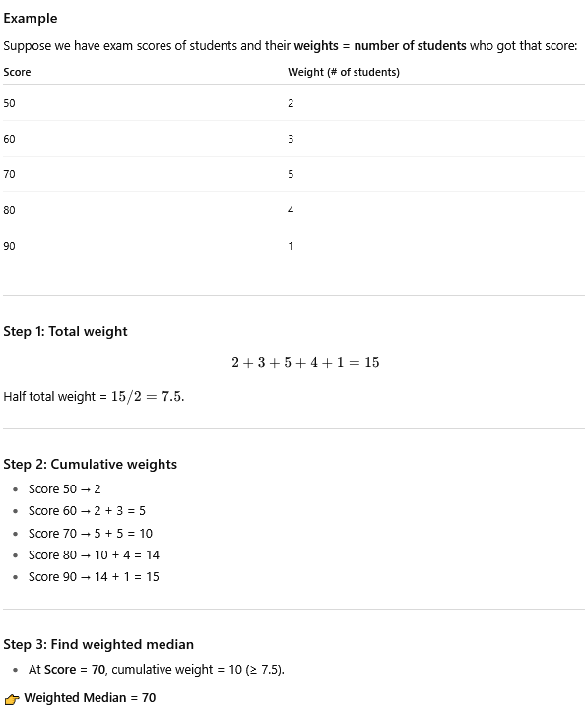
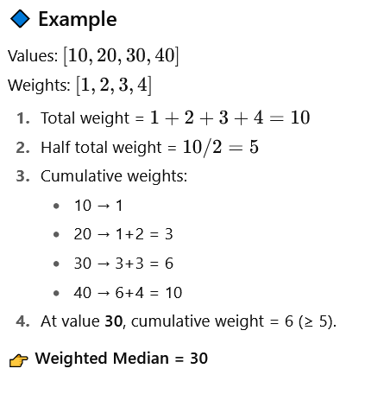

Slide 28
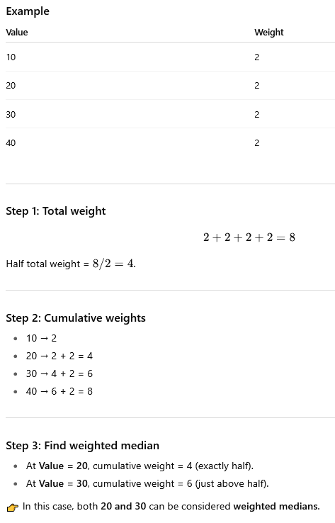

Slide 29
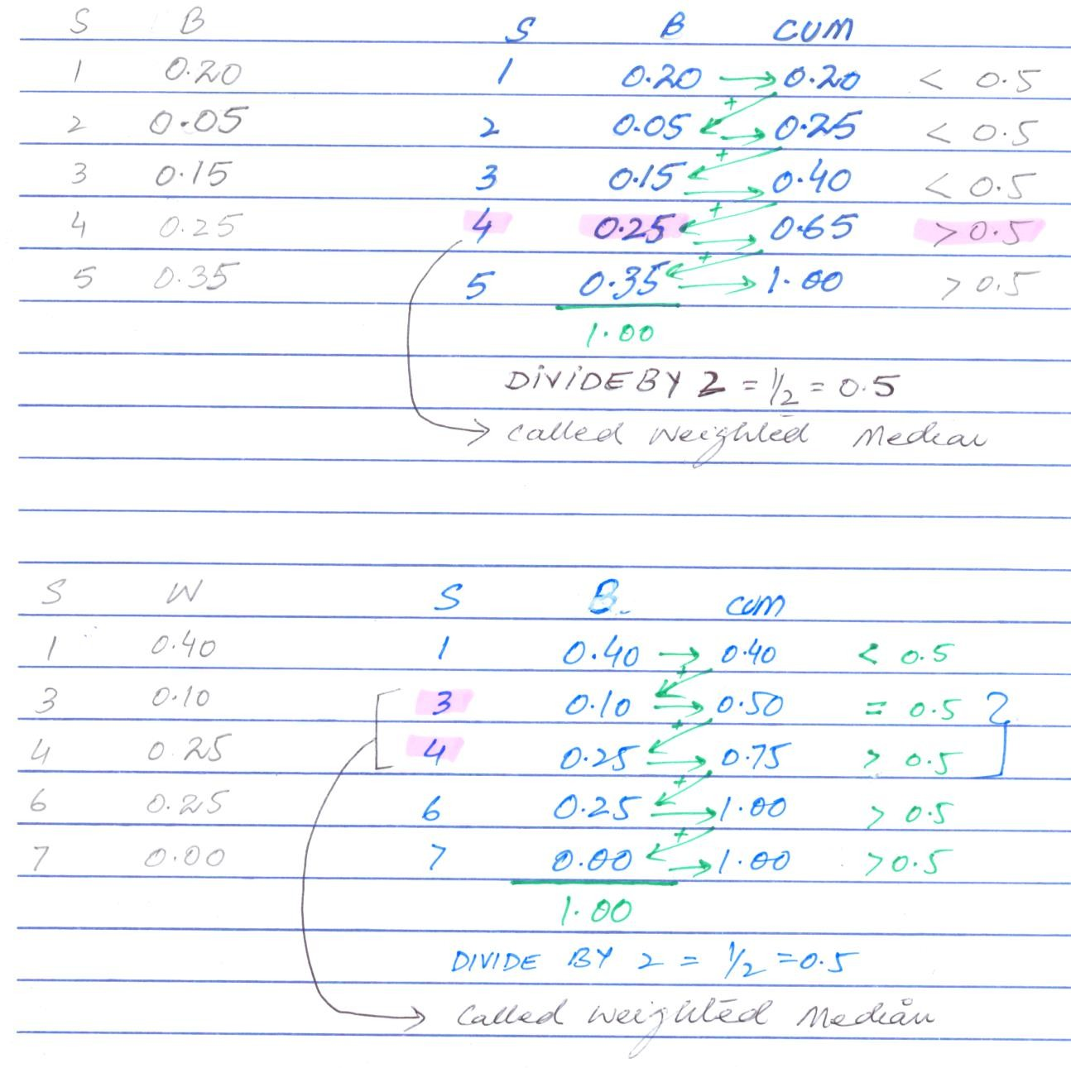
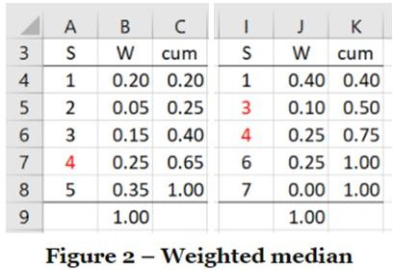
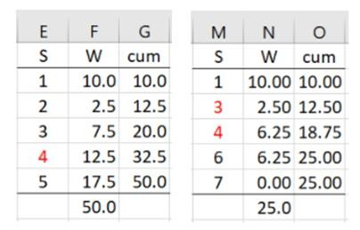
Weighted Median
Solution
Class work
20

Slide 30

Estimates of Location

Slide 31
Outliers
The median is referred to as a robust estimate of location since it is not
influenced by outliers (extreme cases) that could skew the results.
Definition: An outlier is any value that is very distant from the other values in a data set.
The exact definition of an outlier is some‐ what subjective, although
certain conventions are used in various data summaries and plot.
Being an outlier in itself does not make a data value invalid or erroneous
(In case of Bill gates income is not invalid).
  Still, outliers are often the result of data errors such as mixing data of different units (kilometers versus meters) or bad readings from a sensor. When outliers are the result of bad data, the mean will result in a poor estimate of location, while the median will still be valid. In any case, outliers should be identified and are usually worthy of further investigation.

Slide 32
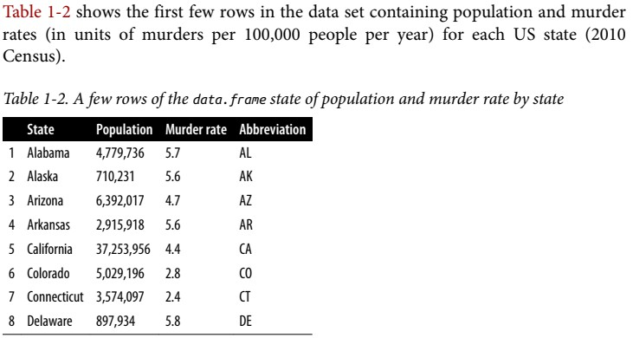
Example: Location Estimates of Population and Murder Rates

Slide 33
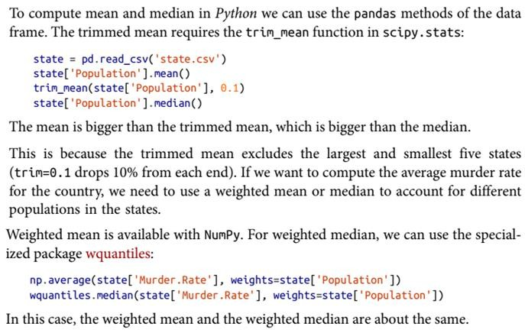
Example: Location Estimates of Population and Murder Rates

Slide 34
